Slide 1
Intro to Machine Learning

Slide 2
Introduction
About Me
My name is Lauren McCarthy
Undergrad in Physics at Barnard College
Astrophysics research at Hayden Planetarium
Completed my Masters in Data Science at Columbia
I am the Head Machine Learning at Instadat
Instadat is a AI firm that focuses predictive analytics in the financial space
Email: lauren@instadat.com

Slide 3
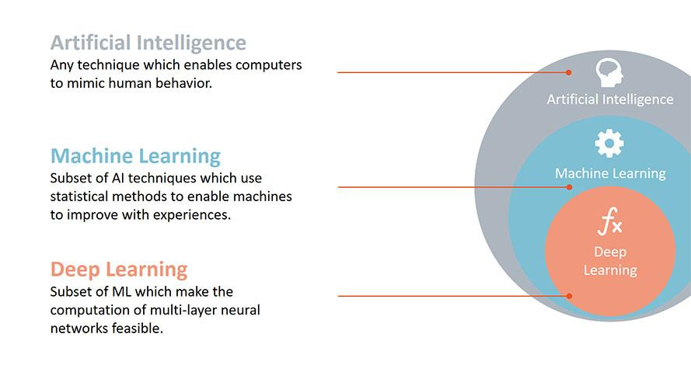
Data Science Key Buzz Words
Artificial Intelligence: Machine Learning (duh!), natural language understanding, language synthesis, computer vision, robotics, sensor analysis, optimization & simulation, among others.
Machine Learning: Deep Learning (another duh!), support vector machines, decision trees, Bayes learning, k-means clustering, association rule learning, regression, and many more.
Deep Learning: artificial neural networks, convolutional neural networks, recursive neural networks, long short-term memory, deep belief networks, and many more.
Big Data

Slide 4
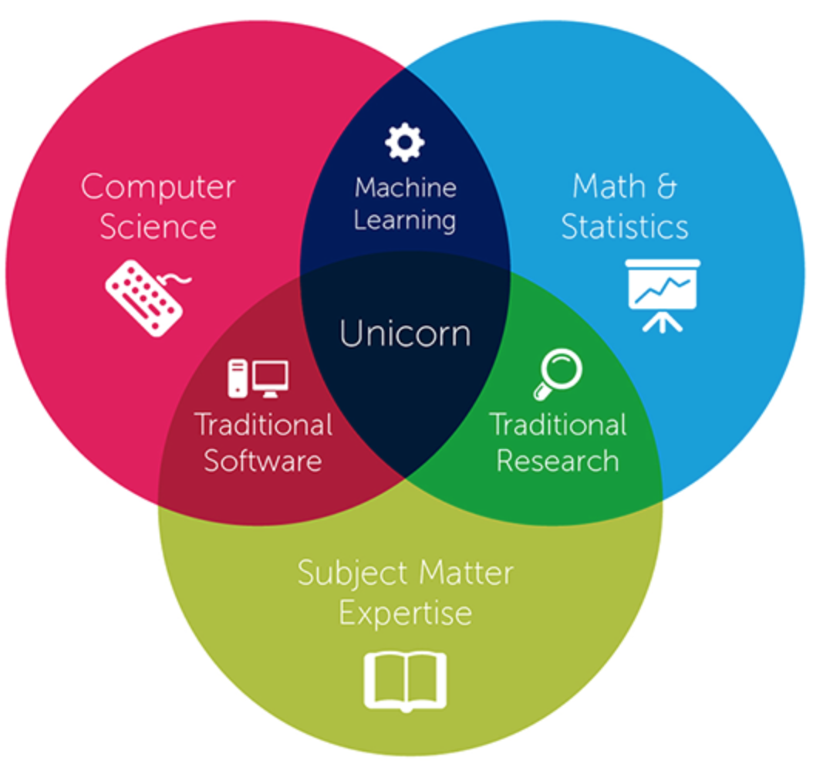
What is Data Science?
The intersection of Computer Science (coding), Statistics, and Subject Matter Expertise.
Where do these skills come in handy: Statistics: making sense of inputs and outputs, Computer Science: Coding algorithms, writing efficient code, Subject Matter Expertise: What are good features, do the columns make sense, etc
Data
Scientist!

Slide 5
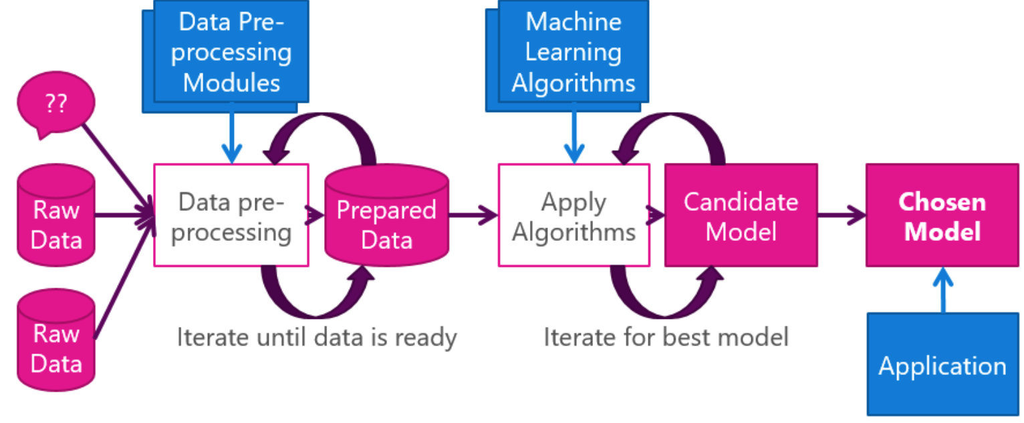
The Process

Slide 6


What is the difference between a good model and a bad model?
You can think of it as a bad model has memorized in the learning process. So when it gets a new example, it gets the right answer sometimes but it not guaranteed.
A good model, has learned specific patterns in the data, so when it sees certain conditions being met it can appropriately predict the answer.

Slide 7
Goals of this class
Feel comfortable grabbing data and performing an exploratory analysis of it.
Main steps:
Understand the problem
Univariable study
Multivariate study
Basic cleaning
Test assumptions
Schedule:
6:30-7:10 First part of the class ~ 40min
7:10-7:20 Break for 10min
7:20-8:00 Second part of the class ~40min
8:00-8:30 ~30min for questions after the class and if you have to leave feel free.

Slide 8
How to pick a good dataset?
Do I have enough observations that I think I can properly represent a population?
Is there a selection bias in the population? Am I representing the whole population?
Where is the data coming from? Is the source reliable?

Slide 9
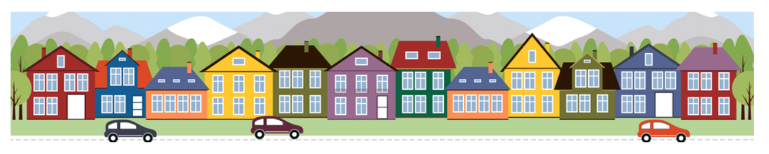
The Dataset for the class
We will be looking at housing data from a kaggle competition:
https://www.kaggle.com/c/house-prices-advanced-regression-techniques
Ask a home buyer to describe their dream house, and they probably won't begin with the height of the basement ceiling or the proximity to an east-west railroad. But this playground competition's dataset proves that much more influences price negotiations than the number of bedrooms or a white-picket fence. With 79 explanatory variables describing (almost) every aspect of residential homes in Ames, Iowa, this competition challenges you to predict the final price of each home.

Slide 10
Know your Data!
Data Types:
Qualitative vs. Quantitative
Qualitative = categorical (ex. red, green, yellow)
Quantitative = numerical (ex. 1,2,3,4 in description of number of children)
Discrete vs. Continuous
Discrete is a finite amount: ex) 4 children, you can’t have 4.5 children
Continuous is never ending: ex) The weight of a person. They could be 121.1 or 121.3, etc.
Dependent vs. Independent
A dependent variable is the “output” variable - in machine learning we say target
An independent variable is the “input” variable - in machine learning we say features

Slide 11
Let’s Dive in
In order to really understand our data, we should look at each variable and try to understands its relevance in the problem.
This may seems very time consuming... but it is really the only way to truly understand the data.
I tend to go through and perhaps pick a few variables that I think could be influencers, this is a good way to get a little familiar with the data before really diving in.
GrLivArea: Above grade (ground) living area square feet
TotalBsmtSF
OverallQual: Rates the overall material and finish of the house
YearBuilt: Original construction date

Slide 12
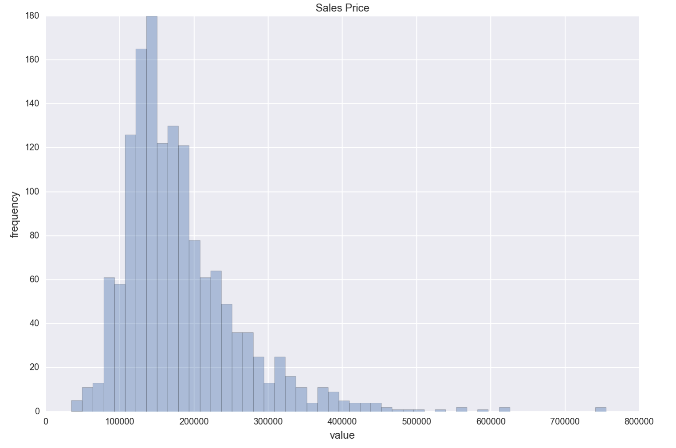
First Let’s take a look at our most important variable! ‘SalePrice’
Let’s begin by look at the targets first - here we can see that the distribution of the targets is right-skewed.
This makes sense as there are fewer houses that are very high prices.
Truncated on left because you can’t go below zero.

Slide 13
Summarizing a distribution
central tendency: Do the values tend to cluster around a particular point?
Mean: average of all the point
Median: the middle of all the points - when distribution is highly skewed
modes: Is there more than one cluster?
spread: How much variability is there in the values?
tails: How quickly do the probabilities drop off as we move away from the modes?
outliers: Are there extreme values far from the modes?
summary statistic: A statistic that quantifies some aspect of a distribution, like central tendency or spread.
variance: A summary statistic often used to quantify spread.
standard deviation: The square root of variance, also used as a measure of spread.

Slide 14
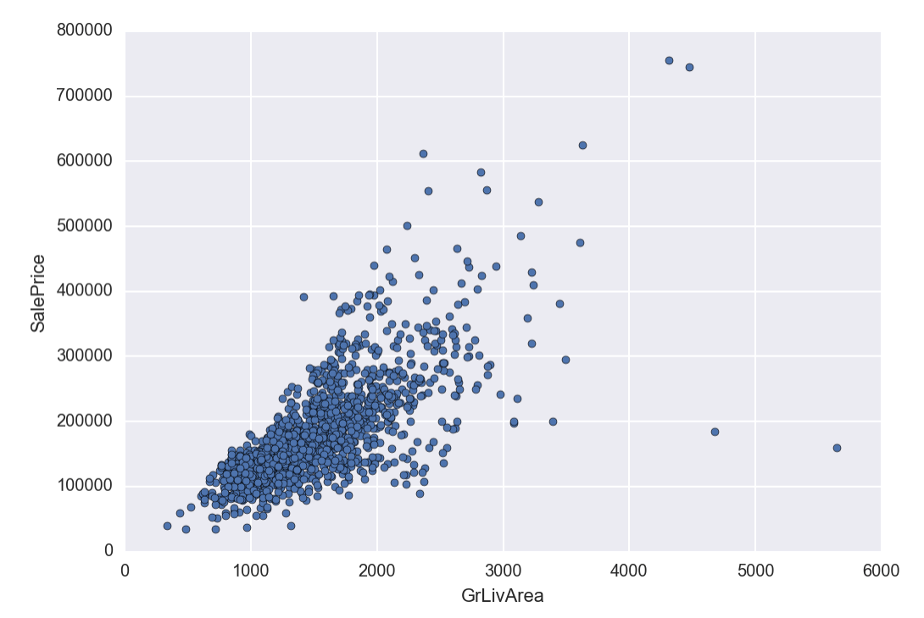
Relationship with numerical variables
Let’s look at a relationship of some of the variables to the target. And see if the relationships looks linear?
Let’s take the GrLivArea: Above grade (ground) living area square feet
This looks fairly linear
Perhaps there are a few outliers in the top and on the bottom right

Slide 15
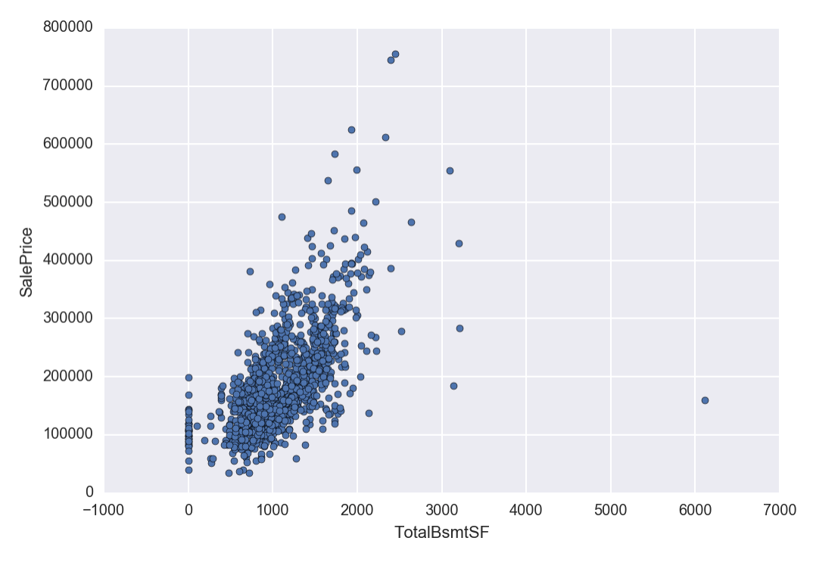
Let’s look at one more:
This variable is TotalBsmtSF: Total square feet of basement area.
When looking at this distribution it could be exponential?

Slide 16
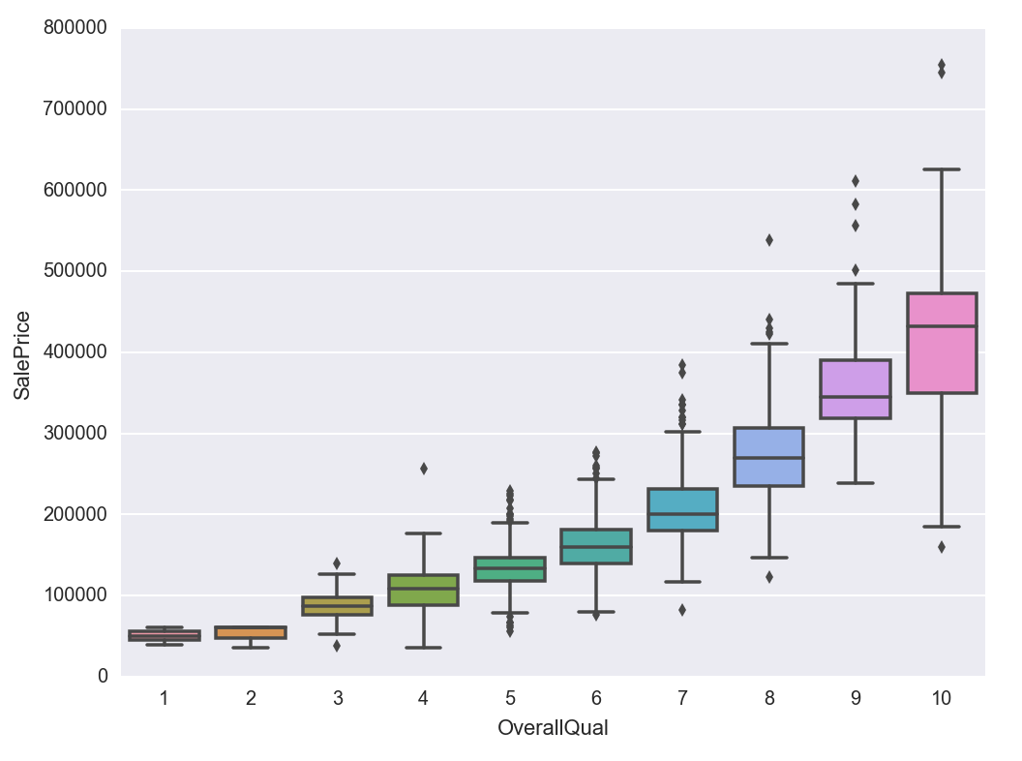
Relationship w/ Categorical Variables
Our first Categorical Variable will be OverallQual: Rates the overall material and finish of the house.
Very clear that there is a correlation between quality and price.

Slide 17
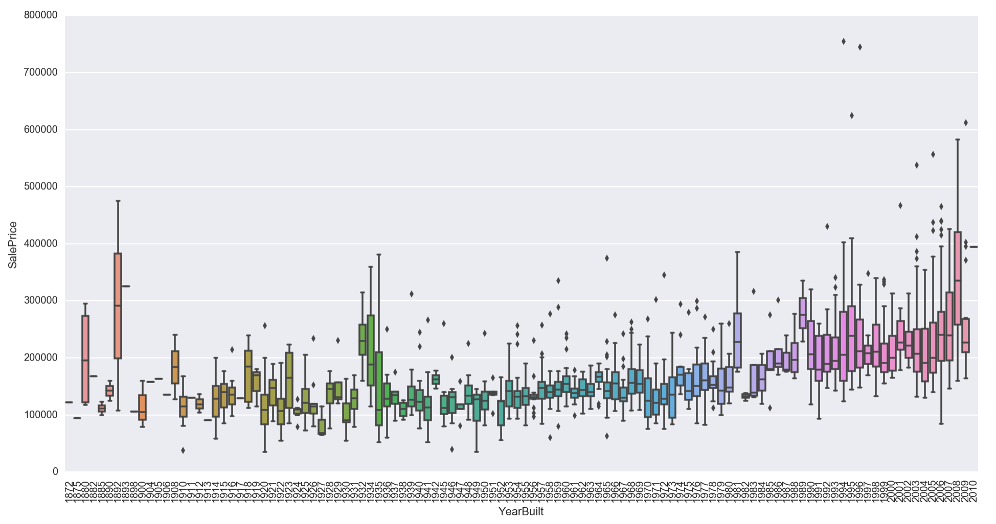
Let’s look at one more:
This is more challenging. But perhaps you would conclude that the more recent the building the higher the price

Slide 18
In Summary...
So far we have looked at a few variables which we thought would have good correlations, and have determined they do!
But what about all the other variables?
What about the variables that we wouldn’t think to have correlation but do!
This is what computers are for, is finding patterns and data that the human wouldn’t think.
Let’s do a more general review?

Slide 19
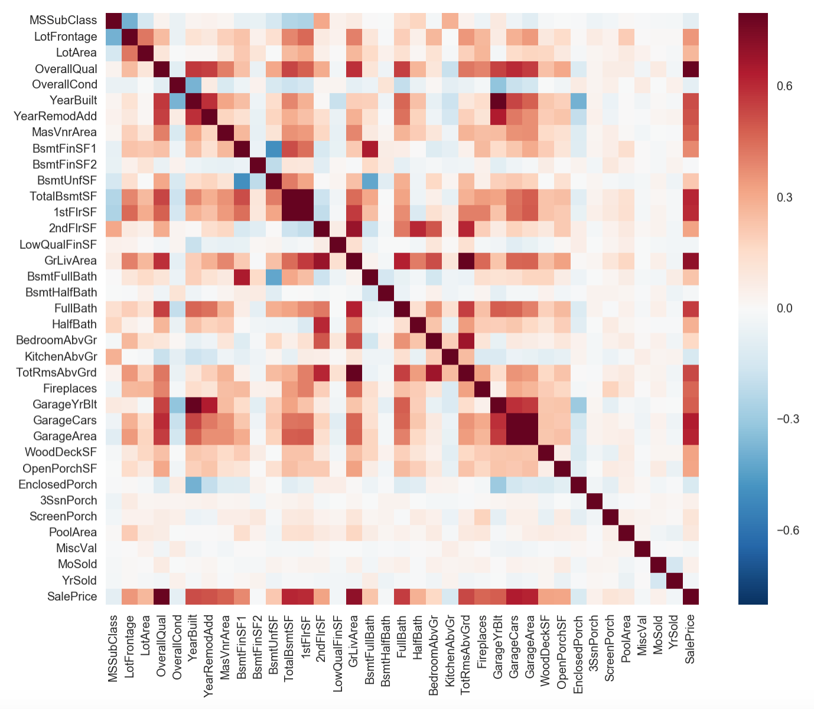
Correlation Matrix
Using seaborn heatmap we can really quickly see the relationships between variables.
Things to look for are dark boxes all the way to the right but also dark boxes between the correlated variables = collinearity.

Slide 20
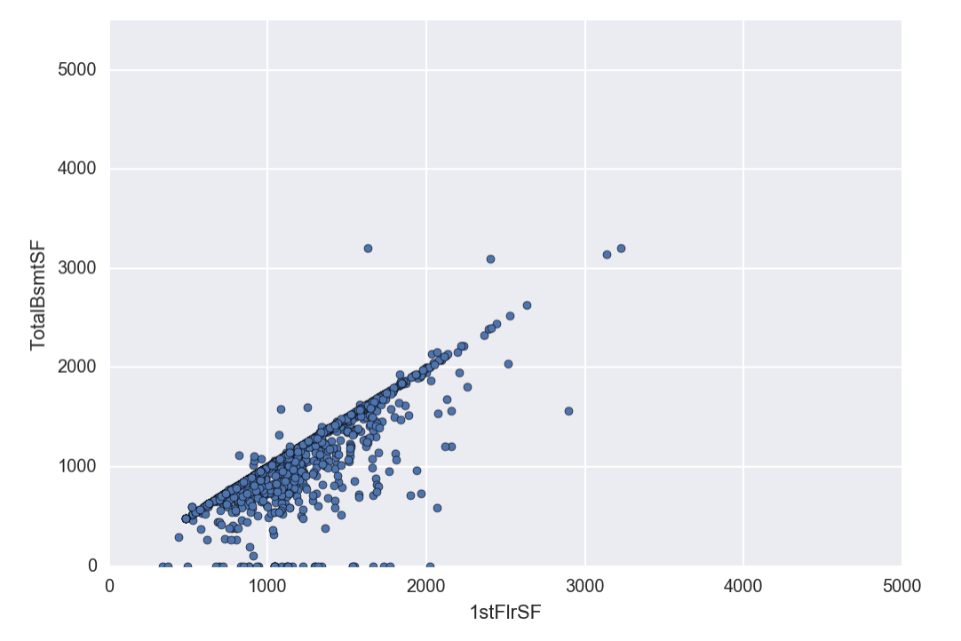
Collinearity
Collinearity just means that the feature encodes almost the same information.
When we calculate the correlation value we get: .82
And given the descriptions, we can say they are basically encoding the same thing.

Slide 21
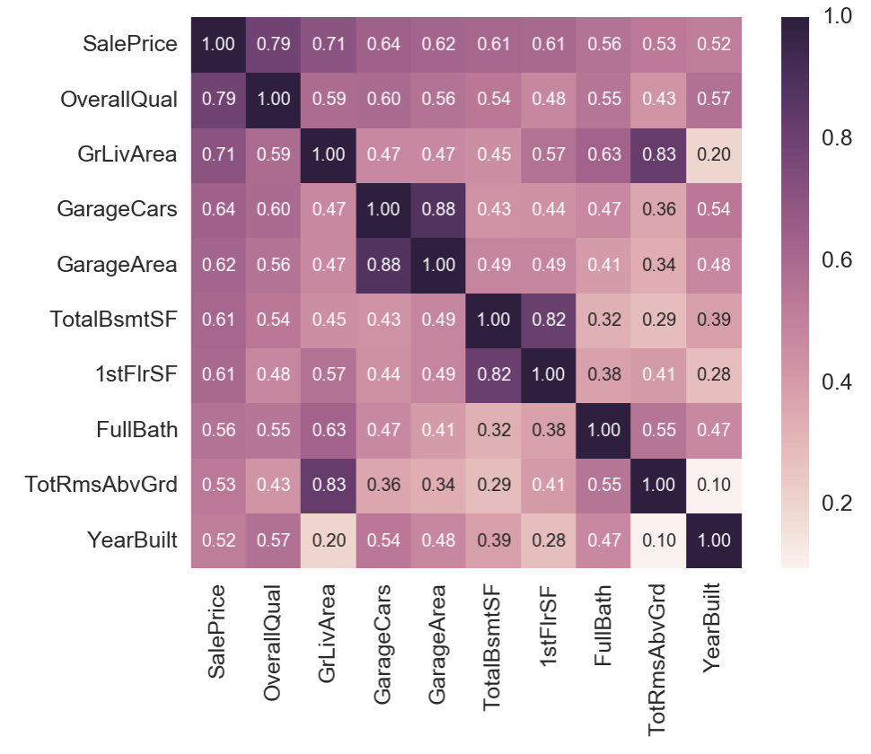
Let’s zoom in on the top 10 features
Great we are learning more and more.
These features seems to make sense at the top features

Slide 22
Scatter plots for top 10 functions
These can allow us to look deeper into the relationships between the variables.
Exponential?
Log?
Linear?

Slide 23
Now let’s look into Missing Data
Important questions when thinking about missing data:
How prevalent is the missing data?
Is missing data random or does it have a pattern?
Need to ensure that the missing data is not biased
Need to also confirm that we are not reducing the data set by mistake because of missing data.
Let’s do some analysis...

Slide 24
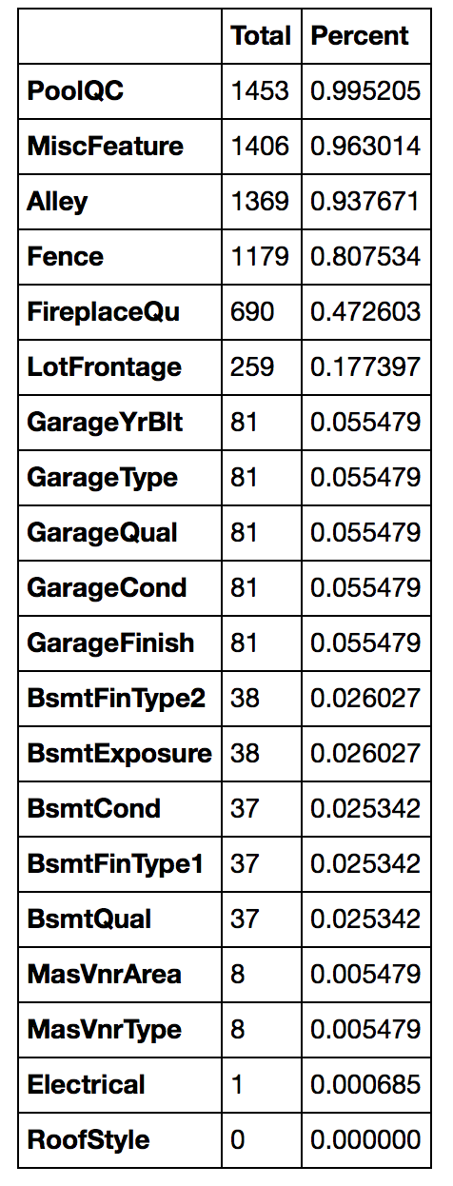
Missing Data Explored
This is only the top 20 largest missing data variables.
We just look at the top because they drop of to 0 and then the rest are zero meaning they are all filled in!
Let’s make a cut off. That if the data is over 90% null we remove it from the data set.
This will remove PoolQC, MiscFeature, Alley, Fence. For the most part I think this data is not integral to the dataset and so we feel okay deleting it.
For the rest, we will figure out the best way to fill in the data given the specific variable.

Slide 25
Missing Data continued...
Where there is missing data in the variables with Garage+str, we see that it is all the same rows missing this data. Since it is only 5% of the data set we delete these.
We also have another variable that covers how many cars the Garage holds.
Therefore these other variables are perhaps less important.
Let’s do the same for Bsmt variables

Slide 26
What to do with the Last 3
MassVnrArea
MassVnrType
Electrical
Lastly we delete these too. They make up so little of the data and therefore we remove them.
However, other techniques to fill in data are:
Fill in median
Fill in mean
Use a recommender system to fill in what most likely

Slide 27
Outliers
Outliers are very important when modeling.
They can affect our models and can be a valuable source of information, providing us insights about specific behaviors.
Most of the time you can visually see outliers, there are also ways we can define a threshold for outliers by using standardization and looking at the max and min of the target value.
Standardization = convert the data values to have a mean of 0 and a standard deviation of one.

Slide 28
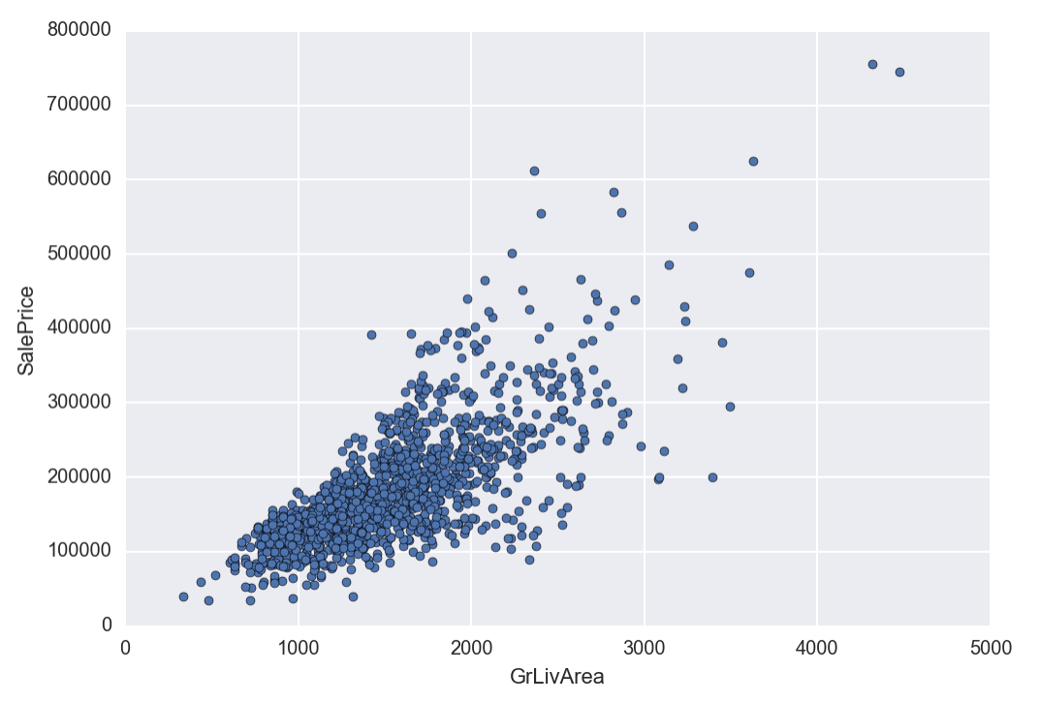
Removing points...

Slide 29
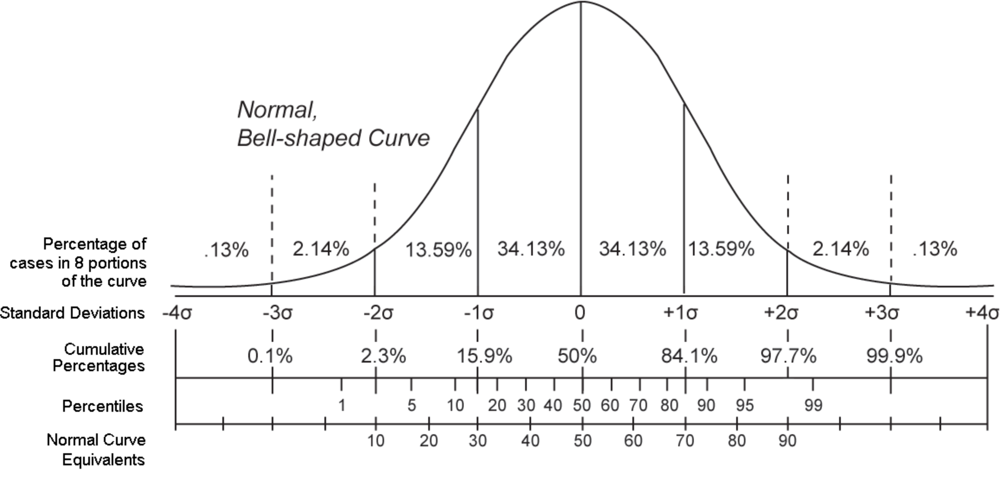
Percentiles can also remove outliers

Slide 30
One of the main assumptions to test a Linear model is that the variables need to be Normal!
As we saw previously...the target values (SalesPrice) was NOT normal.
We also saw some of the other continuous variables were skewed.
Not it is time to look into those.

Slide 31
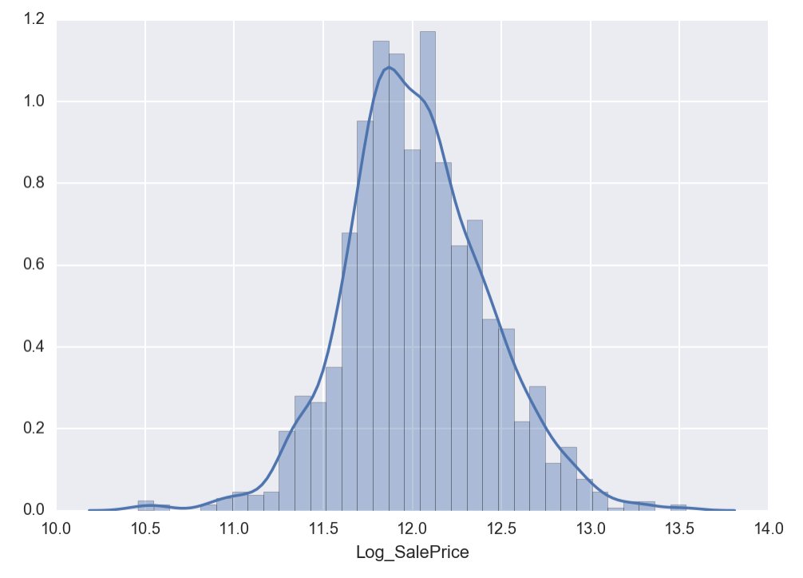
Let’s try to transform the distribution:
Let’s use Log transformation!
General rule of thumb: in the case of positive skewness, log transformations usually work well.

Slide 32
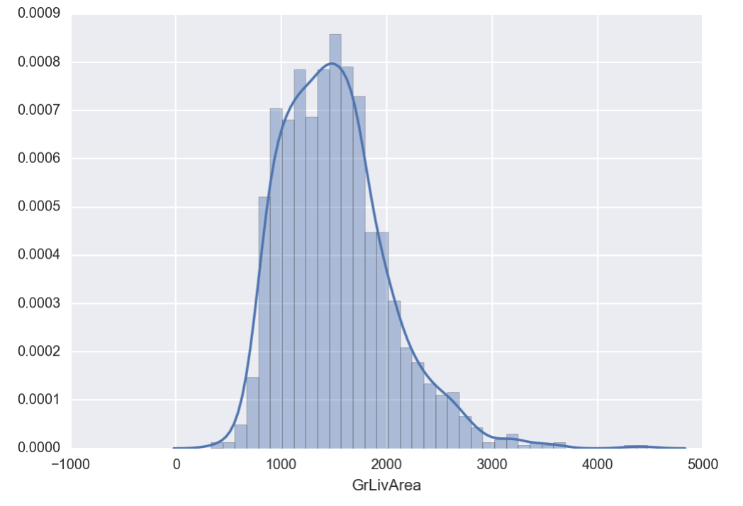
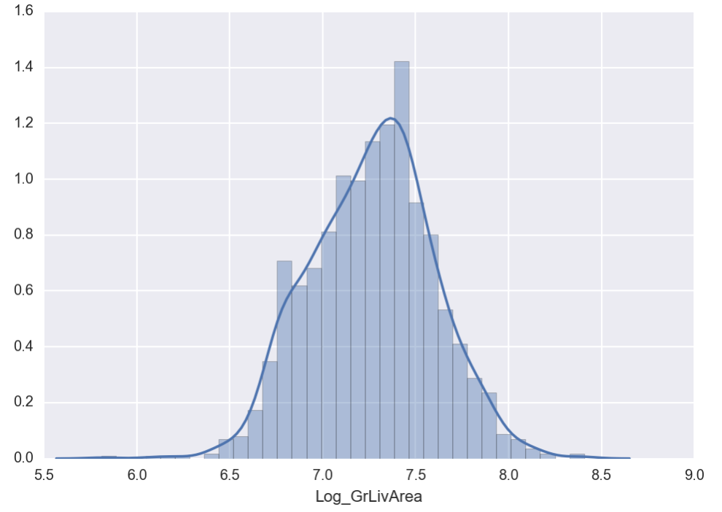
Looking at our next variable:

Slide 33
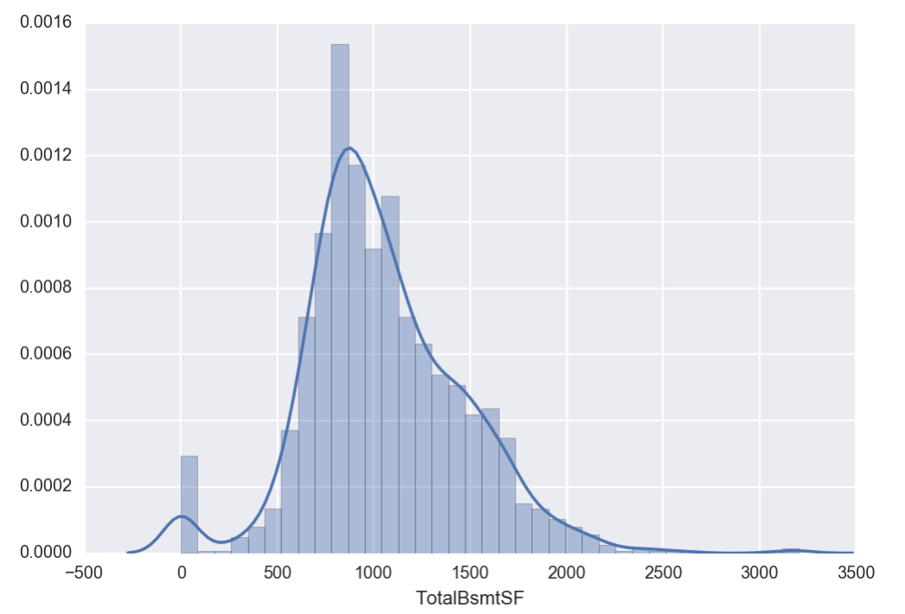
Let’s look at this one in particular
Something in general that represents skewness
A significant number of zero observation (houses without basements
Because of the zero values we can’t do log
Perhaps we do a type of feature create

Slide 34
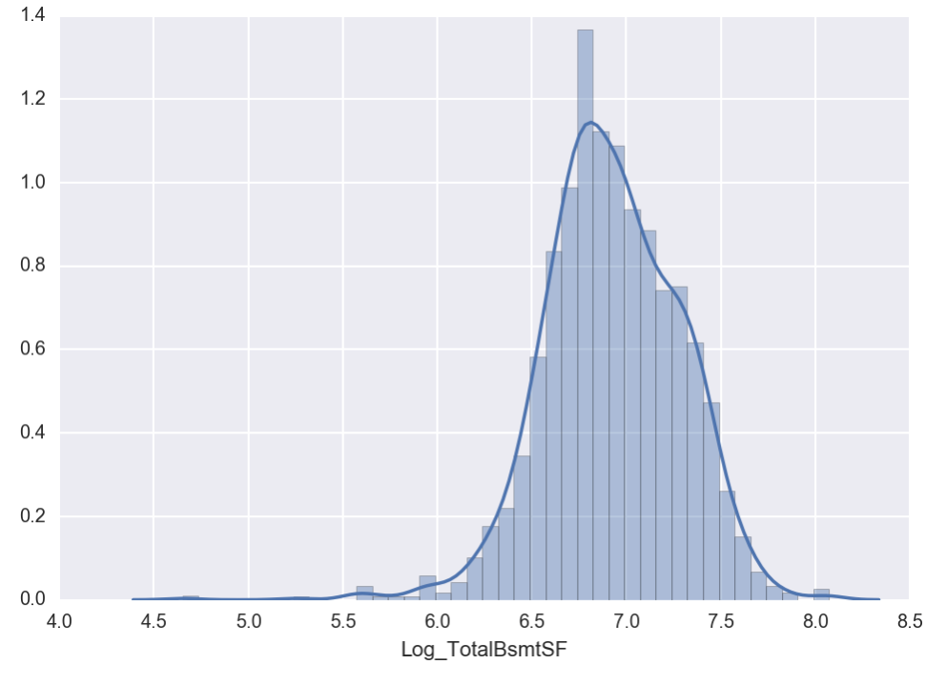
Let’s create a feature that means if there is a basement or not
Then we can log transform the values that are non-zero
We will look into more feature create the next class

Slide 35
Lastly but not least!
As we mentioned earlier - we must know our variable types!
While we saw that continuous variables need to be transformed if they are not normal.
Categorical variables if they are strings also need to be transformed, as machine learning algorithms cannot deal with string values.
We can do this easily by dummy encoding.
Colors | Colors_BLUE | Colors_GREEN | Colors_RED | Colors_YELLOW
RED | 0 | 0 | 1 | 0
GREEN | 0 | 1 | 0 | 0
BLUE | 1 | 0 | 0 | 0
BLUE | 1 | 0 | 0 | 0
YELLOW | 0 | 0 | 0 | 1

Slide 36

Next Time!
Supervised vs. Unsupervised Learning
Linear Regression
Cost Function
Gradient Descent
Feature Engineering
Classification
Cost Function
Optimization
Binary vs. Multiclass
Overfitting
Regularization
Neural Networks
BackProp
Hyperparameter Tuning
Other Methods
SVM
Bagging
Boosting
Random Forests
Train/Test/Cross Validation Sets
Bias vs. Variance

Slide 37
Bibliography
Looks of the pictures and analysis were pulled from:
https://www.kaggle.io/svf/1432348/5930e2cb919959142740c2b985dfacf9/__results__.html#Out-liars!
Summary of the problem:
https://www.kaggle.com/pmarcelino/comprehensive-data-exploration-with-python
Some of the content pulled from:
http://greenteapress.com/wp/think-stats-2e/

